Slide 1
Zepto
Porter's Five Force Analysis

Slide 2
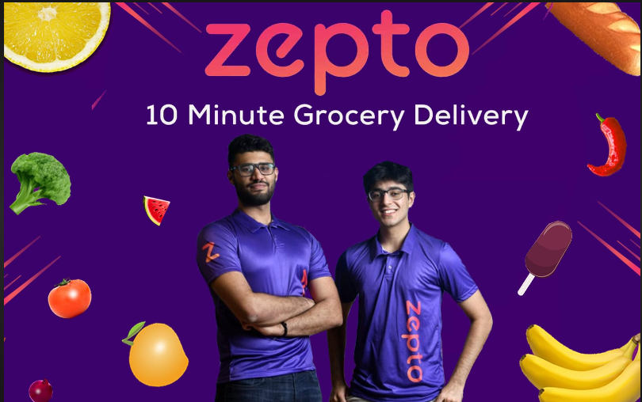
Founded in 2020 by two Stanford University dropouts, Zepto, one of the fastest-growing startups in the ultra-fast commerce service sector, has become the first Indian unicorn of 2023.

Slide 3
Zepto overview
Zepto, a quickly expanding operator in India's quick commerce (e-commerce) market, is well-known for promising to deliver necessities and groceries in as little as ten minutes.
Founders: Aadit Palicha and Kaivalya Vohra
Founded: 2021
Headquarters: Mumbai, India
Industry: Quick Commerce (Q-commerce), Online Grocery Delivery
Core Products: Groceries, daily essentials, and household products
Consumer Behavior: Increasing demand for convenience, time-saving solutions, and the rapid adoption of e-commerce platforms.
Competitors: Blinkit (formerly Grofers), Swiggy Instamart, BigBasket, Dunzo, and Amazon Pantry.

Slide 4
Business Model
Zepto uses a rapid commerce business model, emphasizing hyperlocal delivery to give consumers access to necessities like consumables in under ten minutes.
Dark Stores: Compact warehouses tucked away in crowded cities with the goal of expediting order fulfillment.
Hyperlocal Delivery: Using a network of delivery workers to swiftly and effectively travel short distances.
Technology integration: is the process of managing inventories, estimating demand, and optimizing routes using cutting edge technology.
Revenue sources: Mostly from premium subscription services, supplier commissions, and shipping fees.

Slide 5
Porter's Five Force Analysis
Threat of New Entrants (Low to Moderate)
1
2
Bargaining Power of Suppliers (Moderate)
Porter’s Five Force Analysis
3
Bargaining power of Buyer (High)
4
Threat of Substitutes (Low)
5
Competitive Rivalry (High)

Slide 6
Porter's Five Force Analysis
Threat of New Entrants (Low to Moderate):
Zepto and other fast commerce grocery delivery services demand significant investments in infrastructure and a well-functioning supply chain network. For new players, this presents a barrier to entry.
Bargaining Power of Suppliers (Moderate):
Food manufacturers and wholesalers are examples of suppliers in the grocery business who usually have a moderate amount of negotiation power. Although grocery delivery services depend on a consistent supply of goods, most products have several providers.
Threat of Substitutes (Low):
There is not much of a threat from replacements. Although clients have the option to use meal kits or traditional in-store food shopping, these options do not give the same degree of convenience and speedy delivery as services like Zepto and Blinkit..
Bargaining power of Buyer (High):
There are several competitors in the very competitive sector of quick commerce, including Blinkit, Dunzo, Swiggy, and others. As a result, customers have a variety of options, and they may quickly move between suppliers depending on aspects like cost, delivery time, and service quality. Here's where Zepto's quicker and more dependable distribution mechanism gives it an advantage over competitors.
Competitive Rivalry (High):
Intense competition exists in the quick commerce grocery delivery market. The main factors influencing this rivalry are price, product selection, customer service, and delivery efficiency. As a result, ongoing innovation and capacity building are necessary.

Slide 7
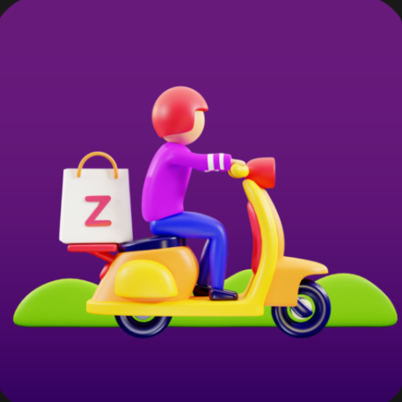
A corporation needs a lot of things to succeed, and Zepto has everything and is currently active in India's major cities. Anyway, the business hasn't revealed its consumer calculation, but according to a few sources, Zepto is expanding at a pace of 200% every month. They are goal-focused, responsive, and have an excellent team. Furthermore, they meticulously strategized their entry into the supermarket delivery industry. Even though they have only been in business for a short while, they have already raised customer expectations and are moving toward a client-focused business model.
Conclusion

Slide 8


